Slide 1
Filtering and Edge Detection
ENGR 430 Computer Vision
Matthew Stein
Roger Williams University
With slides from
Szymon Rusinkiewicz
Princeton University
2012

Slide 2
Local Neighborhoods
Hard to tell anything from a single pixel
Example: you see a reddish pixel. ▪
Is this the object’s color? Illumination? Noise?
The next step in order of complexity is to look at local neighborhood of a pixel

Slide 3
Linear Filters
Given an image In(x,y) generate a new image Out(x,y):
For each pixel (x,y), Out(x,y) is a linear combination of pixels in the neighborhood of In(x,y)
This algorithm is
Linear in input intensity
Shift invariant (“LSI” means In(x+n,y+n)⇒Out(x+n,y+n) )

Slide 4
Simple Filter
234 | 228 | 175
220 | 184 | 166
218 | 193 | 128
Produce a NEW value for each pixel by averaging the values of the pixel’s (8) neighbors
Maybe itself too (9)
What about edges?
Let’s try…..

Slide 5
Discrete Convolution
This is the discrete analogue of convolution
Pattern of weights = “filter kernel”
Will be useful in smoothing, edge detection

Slide 6
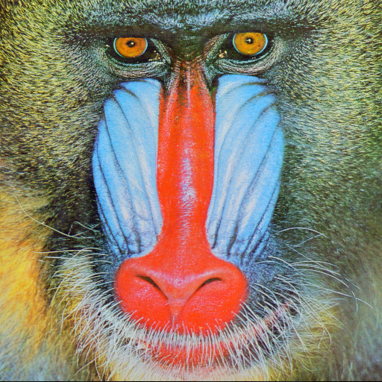

Example: Smoothing
Original: Mandrill
Smoothed with Gaussian kernel

Slide 7
Gaussian Filters
One-dimensional Gaussian
Two-dimensional Gaussian

Slide 8
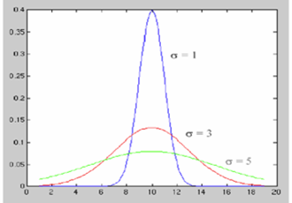
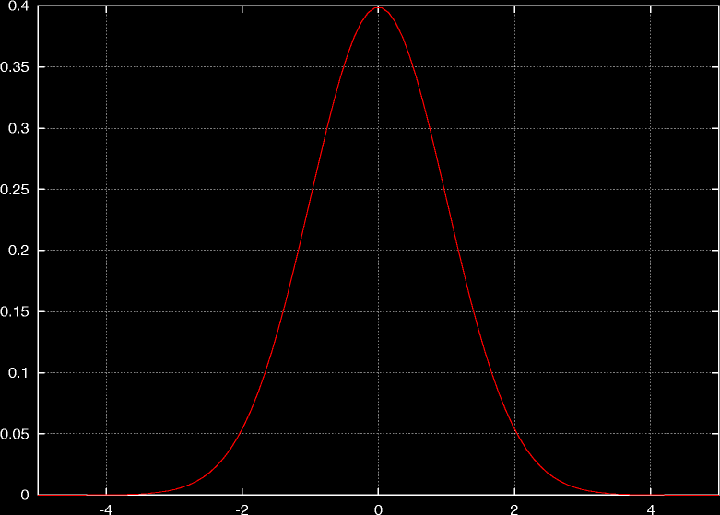

1-D Gaussian Filters

Slide 9
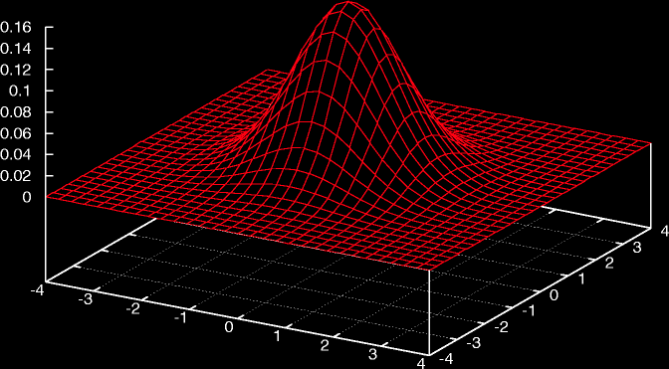
2-D Gaussian Filters

Slide 10
Gaussian Filters
Gaussians are used because:
Smooth
Decay to zero rapidly
Can you imagine why this is important?
Simple (?) analytic formula
Limit of applying multiple filters is Gaussian (Central limit theorem)
Separable G₂(x,y) = G₁(x) G₁(y)
Let’s try…

Slide 11
Convolution
The response of a linear shift-invariant system can be described by the convolution operation
R
=
∑
H
F
ij
i
−
u
,
j
−
v
uv
u
,
v
Input image
Output image
Convolution filter kernel
Convolution notations

Slide 12
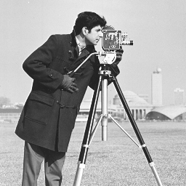
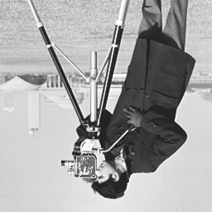
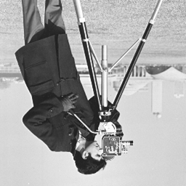
Convolution
Think of 2D convolution as the following procedure
For every pixel (i,j):
Line up the image at (i,j) with the filter kernel
Flip the kernel in both directions (vertical and horizontal)
Multiply and sum (dot product) to get output value R(i,j)
(i,j)

Slide 13
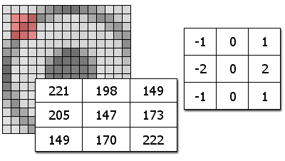
Convolution
For every (i,j) location in the output image R, there is a summation over the local area
H
F
R_{4,4} = H_{0,0}F_{4,4} + H_{0,1}F_{4,3} + H_{0,2}F_{4,2} + H_{1,0}F_{3,4} + H_{1,1}F_{3,3} + H_{1,2}F_{3,2} + H_{2,0}F_{2,4} + H_{2,1}F_{2,3} + H_{2,2}F_{2,2}
= -1*222+0*170+1*149+ -2*173+0*147+2*205+ -1*149+0*198+1*221
= 63

Slide 14
Convolution: example
mirror
shift
n
n
1 1 4 1
0 2 5 3
0 1 2
x(m,n)
1 1 1
0 1 -1
0 1
h(m,n)
-1 1
1 1
h(-m, -n)
-1 1
1 1
h(1-m, n)
m
m
0 0 0 0
0 -2 5 0
0 0 0 0
y(1,0) = Σ _{k,l} x(k,l)h(1-k, -l) =
= 3
n
1 5 5 1
3 10 5 2
2 3 -2 -3
y(m,n)=
verify!
m

Slide 15
Computing Discrete Convolutions
If In is n×n, f is m×m, takes time O(m²n²) “order of”
OK for small filter kernels, bogs down for large ones
May be unacceptable if making decisions in “real time” based on vision

Slide 16
Computing Discrete Convolutions
What happens near edges of image?
Ignore (Out is smaller than In)
Pad with zeros (edges get dark)
Replicate edge pixels
Wrap around
Reflect
Change filter

Slide 17
Fourier Transforms
Define Fourier transform of function f as
F is a function of frequency – describes how much of each frequency f contains
Fourier transform is invertible

Slide 18
Fourier Transform and Convolution
Fourier transform turns convolution into multiplication: F (f(x) ° g(x)) = F (f(x)) F (g(x))

Slide 19
Fourier Transform and Convolution
Useful application #1: Use frequency space to understand effects of filters
Example: Fourier transform of a Gaussian is a Gaussian
Thus: attenuates high frequencies
×
=
Amplitude
Amplitude
Amplitude
Frequency
Frequency
Frequency

Slide 20
Fourier Transform and Convolution
Useful application #2: Efficient computation
Fast Fourier Transform (FFT) takes time O(n log n)
Thus, convolution can be performed in time O(n log n + m log m)
Greatest efficiency gains for large filters

Slide 21
Edge Detection
What do we mean by edge detection?
What is an edge?

Slide 22

What is an Edge?
Edge easy to find

Slide 23

What is an Edge?
Where is edge? Single pixel wide or multiple pixels?

Slide 24

What is an Edge?
Noise: have to distinguish noise from actual edge

Slide 25

What is an Edge?
Is this one edge or two?

Slide 26
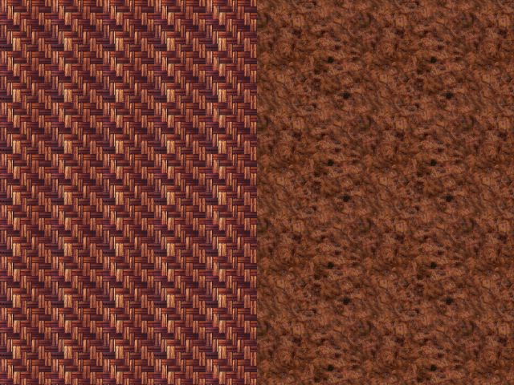
What is an Edge?
Texture discontinuity

Slide 27
Formalizing Edge Detection
Look for strong step edges
dI/dx is spatial rate of change in intensity
τ is some threshold we pick based on our objective
One pixel wide: look for maxima in dI / dx

Slide 28
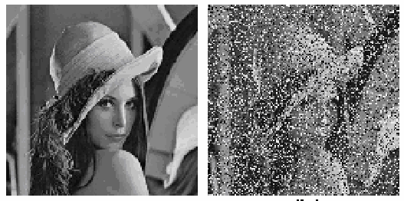
Formalizing Edge Detection
But this produces excessive image “noise”
Can select no threshold τ value that produces uniformly acceptable results
Noise rejection: first smooth (with a Gaussian) over a neighborhood σ

Slide 29
Other Edge Detectors
Can build simpler, faster edge detector by omitting some steps:
No nonmaximum suppression
No hysteresis in thresholding
Simpler filters (approx. to gradient of Gaussian)
Sobel:
Roberts:

Slide 30
Sobel Edge Detector

Slide 31
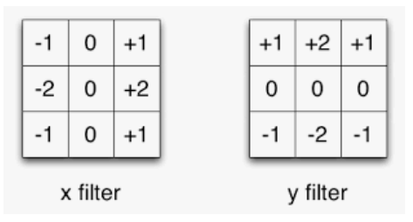

Sobel in two directions
Noise rejection: first smooth (with a Gaussian) over a neighborhood σ
Convert to gray scale
Apply Sobel filter

Slide 32
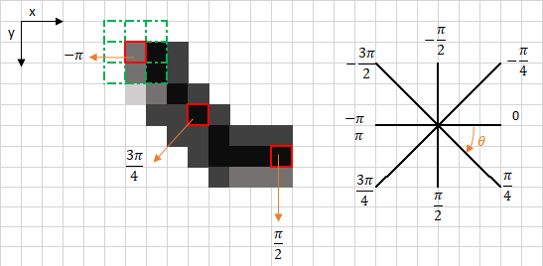
Nonmaximum suppression
Eliminate all but local maxima in magnitude of gradient
At each pixel look along direction of gradient: if either neighbor is bigger, set to zero

Slide 33
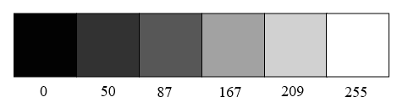
Non-maximum suppression

Slide 34
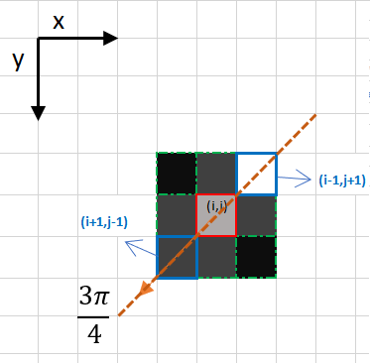
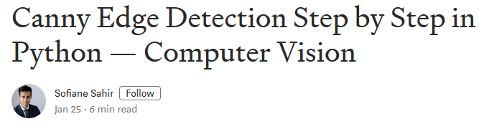
Non-maximum supression
In this case the direction is the orange dotted diagonal line. Therefore, the most intense pixel in this direction is the pixel (i-1, j+1).
Apply to results of Sobel Edge Detector

Slide 35
Canny Edge Detector
Smooth
Find derivative (spatial change in intensity)
Find maxima
Threshold

Slide 36
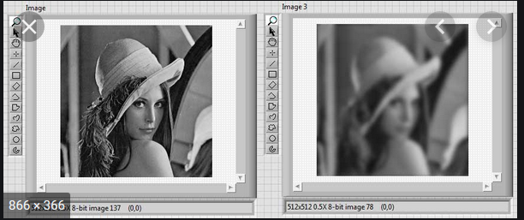
Canny Edge Detector
First, smooth with a Gaussian of some width σ
We did this…

Slide 37
Canny Edge Detector
Next, find “derivative”
What is derivative in 2D? Gradient:

Slide 38
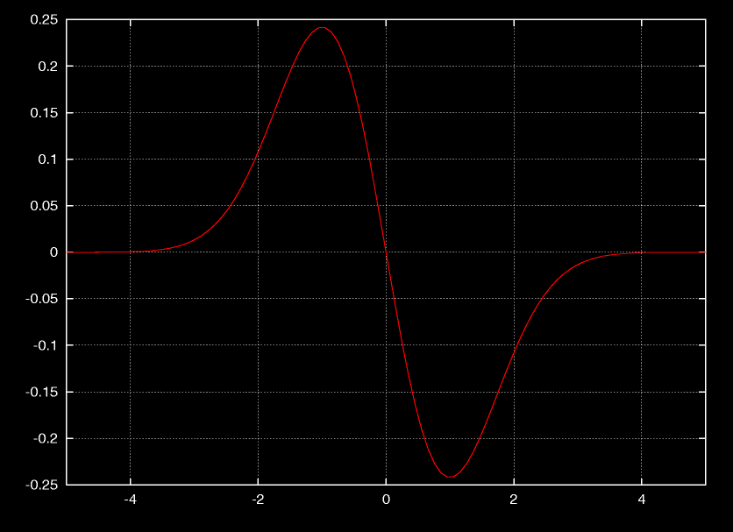
Canny Edge Detector
Useful fact #1: differentiation “commutes” with convolution
Useful fact #2: Gaussian is separable:

Slide 39
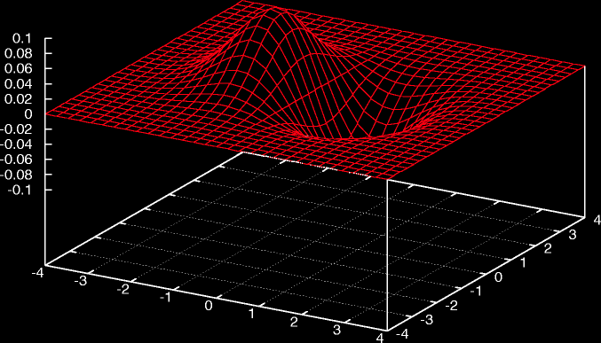
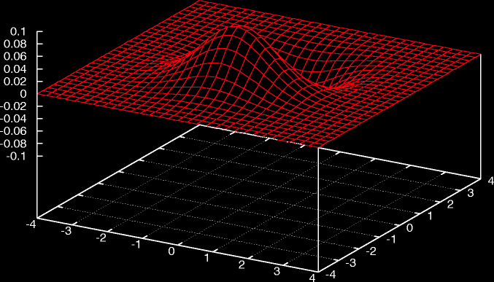
Canny Edge Detector
Thus, combine first two stages of Canny:

Slide 40

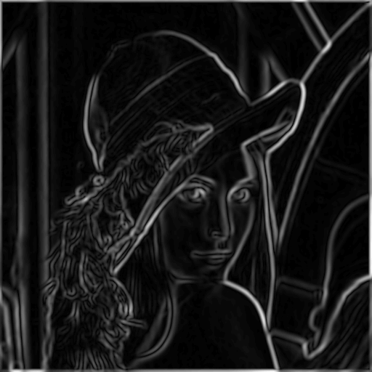
Canny Edge Detector
Original Image
Smoothed Gradient Magnitude

Slide 41
Canny Edge Detector
Final stage: thresholding
Simplest: use a single threshold
Better: use two thresholds
Find chains of edge pixels, all greater than τ _{low}
Each chain must contain at least one pixel greater than τ _{high}
Helps eliminate dropouts in chains, without being too susceptible to noise
“Thresholding with hysteresis”

Slide 42
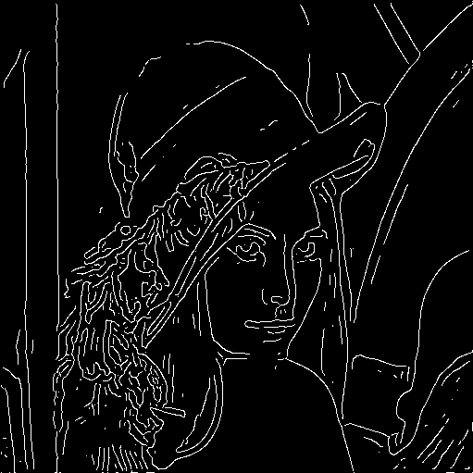
Canny Edge Detector
Original Image
Edges

Slide 43
Second-Derivative-Based Edge Detectors
To find local maxima in derivative, look for zeros in second derivative
Analogue in 2D: Laplacian
Marr-Hildreth edge detector

Slide 44
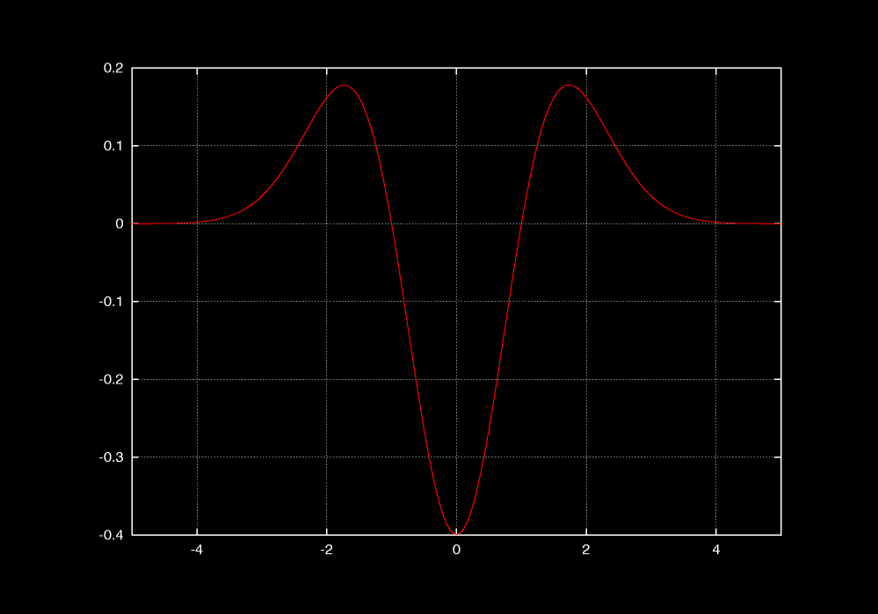
LOG
As before, combine Laplacian with Gaussian smoothing: Laplacian of Gaussian (LOG)

Slide 45
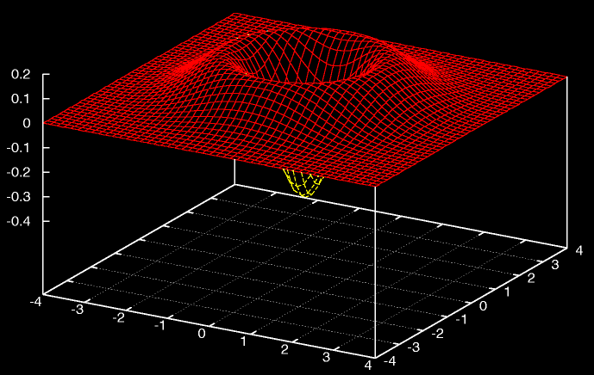
LOG
As before, combine Laplacian with Gaussian smoothing: Laplacian of Gaussian (LOG)

Slide 46
Problems with Laplacian Edge Detectors
Local minimum vs. local maximum
Symmetric – poor performance near corners
Sensitive to noise
Higher-order derivatives = greater noise sensitivity
Combines information along edge, not just perpendicular

